Slide 1
Structured Query Language (SQL) & Indexing
-Unit 4

Slide 2
Overview of SQL
Structured Query Language or SQL is a standard Database language which is used to create, maintain and retrieve the data from relational databases.
Examples of databases are MySQL, Oracle, SQL Server, PostGre, etc. The recent ISO standard version of SQL is SQL:2019.
As the name suggests, it is used when we have structured data (in the form of tables).
All databases that are not relational (or do not use fixed structure tables to store data) and therefore do not use SQL, are called NoSQL databases. Examples of NoSQL are MongoDB, DynamoDB, Cassandra, etc.

Slide 3
SQL is used to perform operations on the records stored in the database, such as
updating records,
inserting records,
deleting records,
creating and
modifying database tables,
views, etc.
SQL is not case sensitive. But it is a recommended practice to use keywords (like SELECT, UPDATE, CREATE, etc) in capital letters and use user defined things (liked table name, column name, etc) in small letters.

Slide 4
Advantages of SQL
Faster Query Processing (High speed)–
Large amount of data is retrieved quickly and efficiently.
Operations like Insertion, deletion, manipulation of data is also done in almost no time.
No Coding Skills –
For data retrieval, large number of lines of code is not required.
All basic keywords such as SELECT, INSERT INTO, UPDATE, etc are used
Standardized Language –
Due to documentation and long establishment over years, it provides a uniform platform worldwide to all its users.

Slide 5
Portable –
It can be used in programs in PCs, server, laptops independent of any platform (Operating System, etc).
Also, it can be embedded with other applications as per need/requirement/use.
Interactive Language –
Easy to learn and understand, answers to complex queries can be received in seconds.
Multiple data view
Using the SQL language, the users can make different views of the database structure.

Slide 6
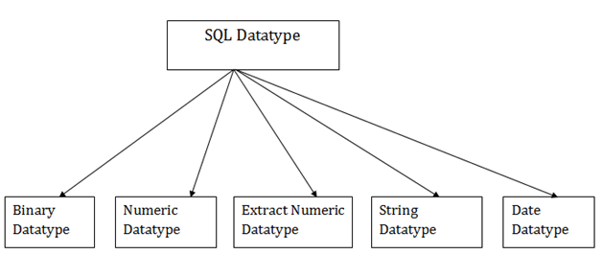
SQL Data types

Slide 7
1. Binary Datatypes
Binary:
It has a maximum length of 8000 bytes.
It contains fixed-length binary data.
Varbinary:
It has a maximum length of 8000 bytes.
It contains variable-length binary data.
2. Approximate Numeric Datatype
Float: Range -1.79E + 308 to 1.79E + 308.
It is used to specify a floating-point value e.g. 6.2, 2.9 etc.
Real: Range -3.40e + 38 to 3.40E + 38.
It specifies a single precision floating point number

Slide 8
3. Exact Numeric Datatype
Bit: It has the number of bits to store. (1 bit)
int: It is used to specify an integer value. (4 bytes)
smallint: It is used to specify small integer value. (2 bytes)
Decimal: It specifies a numeric value that can have a decimal number. (5-17 bytes)
Numeric: It is used to specify a numeric value. (5-17 bytes)
4. Date and time Datatypes
Date:
It is used to store the year, month, and days value.
The DATE data type accepts date values.
No parameters are required when declaring a DATE data type.
Date values should be specified in the form: YYYY-MM-DD.
However, PointBase will also accept single digits entries for month and day values.
Month values must be between 1 and 12, day values should be between 1 and 31 depending on the month and year values should be between 0 and 9999.
Values assigned to the DATE data type should be enclosed in single quotes, preceded by the case insensitive keyword DATE; for example, DATE '1999-04-04'.
Examples
DATE
Valid :DATE '1999-01-01’ DATE '2000-2-2’
Invalid: DATE '1999-13-1’ date '2000-2-30’ '2000-2-27’ date 2000-2-27
Time:
It is used to store the hour, minute, and second values.
Timestamp:
It stores the year, month, day, hour, minute, and the second value.

Slide 9



5. Character String Datatype
Char: fixed-length
It has a maximum length of 8000 characters (can contain letters, numbers, and special characters)
The length of the char is specified while assigning the data type. For e.g. Char(n).
If size is not specified then the default size will be 1byte.
If you assign a value to a CHARACTER column containing fewer characters than the defined length, the remaining space is filled with blanks characters.
Attempting to assign a value containing more characters than the defined length results in the truncation of the character string to the defined length. If any of the truncated characters are not blank, an error is raised.
Varchar: variable-length
It has a maximum length of 8000 characters.
If you need to store character strings that are longer than the current table page size, the Character Large Object (CLOB) data type should be used.
VARCHAR takes up 1 byte per character, + 2 bytes to hold length information.
For example, if you set a VARCHAR(100) data type = ‘Jen’, then it would take up 3 bytes (for J, E, and N) plus 2 bytes, or 5 bytes in all.
Text:
It has a maximum length of 2,147,483,647 characters.
It contains variable-length characters.

Slide 10
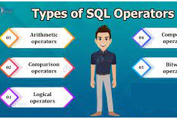
SQL Operators

Slide 11
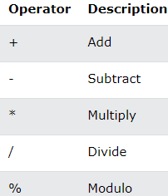
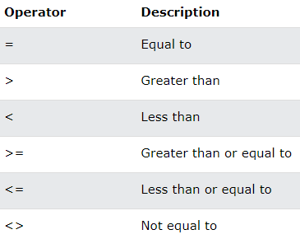
Arithmetic Operators
Comparison Operator

Slide 12
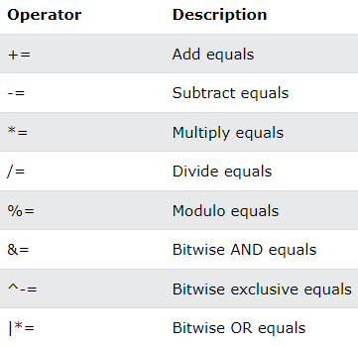
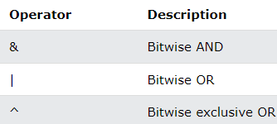
Compound Operators
Bitwise Operator

Slide 13
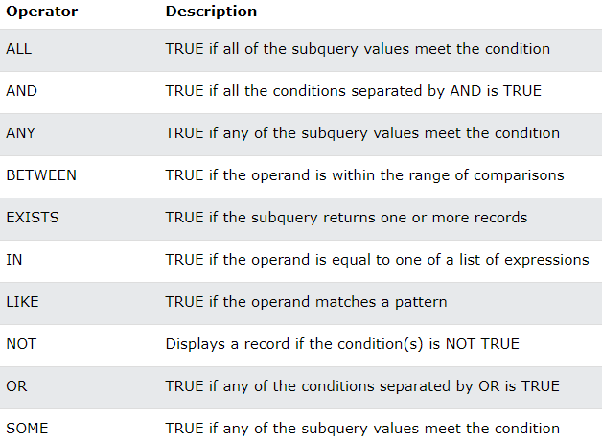
Logical Operators

Slide 14
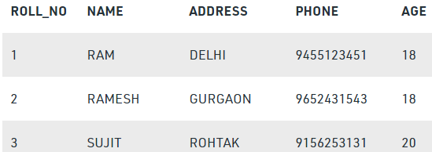
What is Relational Database?
Relational database means the data is stored as well as retrieved in the form of relations (tables).
Table 1 shows the relational database with only one relation called STUDENT,
which stores ROLL_NO, NAME, ADDRESS, PHONE and AGE of students.
STUDENT

Slide 15
Important terminologies that are used in terms of relation.
Attribute (field): Attributes are the properties that define a relation. e.g.; ROLL_NO, NAME etc.
Tuple: Each row in the relation is known as tuple.
Degree: The number of attributes in the relation is known as degree of the relation.
Ex.The STUDENT relation defined above has degree 5.
Cardinality: The number of tuples in a relation is known as cardinality. Ex.The STUDENT relation defined above has cardinality 3.
Column: Column represents the set of values for a particular attribute.
A query: It is an inquiry to the database for information.

Slide 16
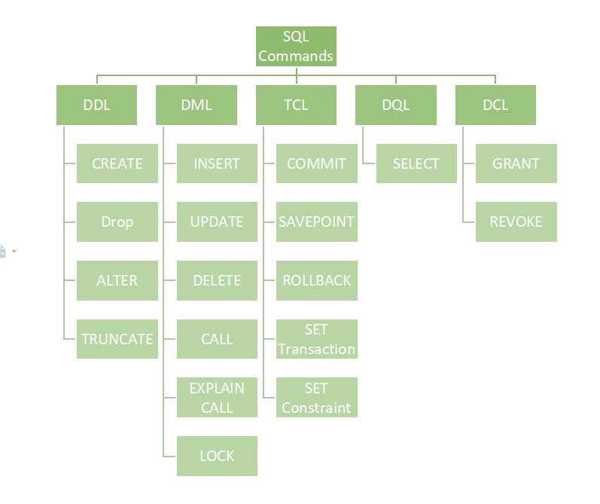
Classification of SQL commands
DDL (Data Definition Language)
DML (Data Manipulation Language)
DCL (Data Control Language)
DQL (Data Query Language)
Transactional control commands

Slide 17
DQL (Data Query Language):
It allows getting data from the database and imposing order upon it.
It includes the SELECT statement.
This command allows getting the data out of the database to perform operations with it.
List of DQL:
SELECT: It is used to retrieve data from the database.
It is also can be used with where clause to retrieve specific record.
Syntax: Select column from <table_name> where <condition>;
Ex. Select * from students where rno=5;

Slide 18
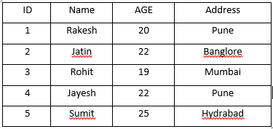
SELECT Command
The SELECT command shows the records of the specified table.
It also shows the particular record of a particular column by using the WHERE clause.
Select statement retrieves the data from database according to the constraints specifies alongside.
Syntax:
SELECT <Col1 , col2 , col3 … , col N> FROM <TABLE NAME>
Here, column_Name_1, column_Name_2, ….., column_Name_N are the names of those columns whose data we want to retrieve from the table.
If we want to retrieve the data from all the columns of the table, we have to use the following SELECT command:
SELECT * FROM table_name;
Example:
Select * from students;

Slide 19
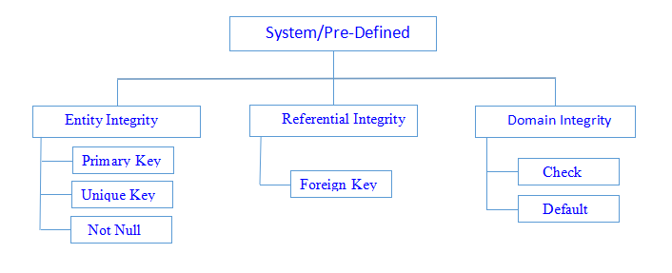
Classification of constraints

Slide 20
SQL constraints
Integrity constraints are a set of rules. It is used to maintain the quality of information.
Integrity constraints ensure that changes made to the database by authorized users do not result in a loss of data consistency.
Thus, integrity constraints guard against accidental damage to the database.
Constraints can be specified when a table is created with the CREATE TABLE statement.
you can use the ALTER TABLE statement to create constraints even after the table is created.
Constraints can be defined in two ways
column-level definition The constraints can be specified immediately after the column definition.
table-level definition The constraints can be specified after all the columns are defined.

Slide 21
NOT NULL Constraints
The NOT NULL constraint in a column means that the column cannot store NULL values.
That is, you will be not allowed to insert a new row in the table without specifying any value to this field.

Slide 22

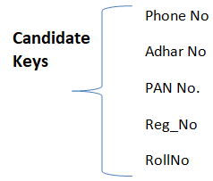
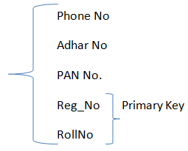

Slide 23
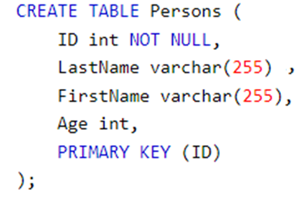
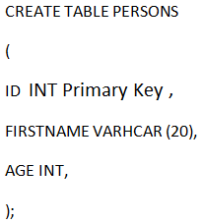
Primary key constraints
Column
This constraint defines a column or combination of columns which uniquely identifies each row in the table.
Primary keys must contain UNIQUE values, and cannot contain NULL values.
A table can have only ONE primary key; and in the table, this primary key can consist of single or multiple columns (fields).
Syntax:
It creates a PRIMARY KEY on the "ID" column when the "Persons" table is created:
Column Level
Table level

Slide 24
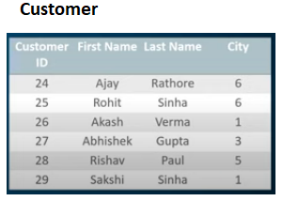
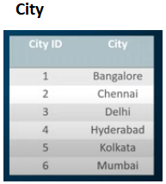
Foreign Key constraints
The FOREIGN KEY constraint is used to prevent actions that would destroy links between tables.
A FOREIGN KEY is a field (or collection of fields) in one table, that refers to the PRIMARY KEY in another table.
The table with the foreign key is called the child table, and the table with the primary key is called the referenced or parent table.

Slide 25
Syntax:
SQL FOREIGN KEY on CREATE TABLE
CREATE TABLE customer (
customerID int NOT NULL,
FirstName varchar(20),
LastName varchar(20)
City int,
PRIMARY KEY (customerID),
FOREIGN KEY (city) REFERENCES City(CityID)
);

Slide 26
Unique constraints
The UNIQUE constraint ensures that all values in a column are different.
Both the UNIQUE and PRIMARY KEY constraints provide a guarantee for uniqueness for a column or set of columns.
A PRIMARY KEY constraint automatically has a UNIQUE constraint.
However, you can have many UNIQUE constraints per table, but only one PRIMARY KEY constraint per table.

Slide 27
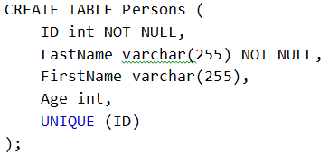
SQL UNIQUE Constraint on CREATE TABLE
The following SQL creates a UNIQUE constraint on the "ID" column when the "Persons" table is created:

Slide 28
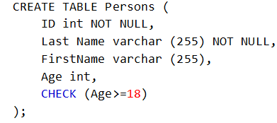
Check constraints
The CHECK constraint is used to limit the value range that can be placed in a column.
If you define a CHECK constraint on a column it will allow only certain values for this column.
SQL CHECK on CREATE TABLE

Slide 29
Default constraints
The DEFAULT constraint is used to set a default value for a column.
The default value will be added to all new records, if no other value is specified.
SQL DEFAULT on CREATE TABLE
To set a DEFAULT value for the “Location” column when the “Venue” table is created –
CREATE TABLE Venue ( ID int NOT NULL, Name varchar(255), Age int, Location varchar(255) DEFAULT ‘Mumbai');

Slide 30
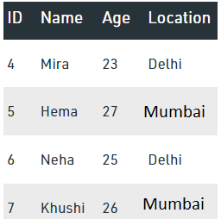
INSERT INTO Venue VALUES (4, 'Mira', 23, 'Delhi');
INSERT INTO Venue VALUES (5, 'Hema', 27);
INSERT INTO Venue VALUES (6, 'Neha', 25, 'Delhi');
INSERT INTO Venue VALUES (7, 'Khushi', 26);
select * from Venue;

Slide 31
DDL COMMANDS

Slide 32
DDL (Data Definition Language):
It is used to define the structure of the database .
DDL actually consists of the SQL commands that can be used to define the database schema. (A schema is a collection of database objects like tables, triggers, stored procedures, etc. )
Data Definition Language, DDL, is the part of SQL that allows a database user to create and restructure database objects, such as the creation or the deletion of a table.
DDL commands :
CREATE
ALTER TABLE
DROP TABLE
TRUNCATE TABLE
RENAME TABLE
CREATE INDEX
ALTER INDEX
DROP INDEX
CREATE VIEW
DROP VIEW

Slide 33

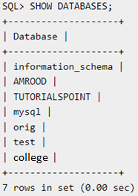
CREATE, SHOW & DROP DATABASE
The SQL CREATE DATABASE statement is used to create a new SQL database.
Syntax:
Example
If you want to create a new database <college>,
SQL> CREATE DATABASE college;
Once a database is created, you can check it in the list:
SQL> SHOW DATABASES;
DROP DATABASE
The SQL DROP DATABASE statement is used to drop an existing database in SQL schema.
Syntax: DROP DATABASE DatabaseName;
Example:
SQL> DROP DATABASE college;

Slide 34
USE Statement
USE statement:
It is used to select any existing database in the SQL schema.
When you have multiple databases in your SQL Schema, then before starting your operation, you would need to select a database where all the operations would be performed.
Syntax: USE DatabaseName;
Example:
SQL> USE college;

Slide 35
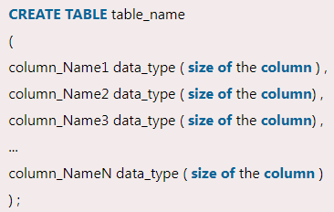
CREATE Table
Creating a basic table involves naming the table and defining its columns and each column's data type.
Syntax :
Note:
The data type of the columns may vary from one database to another.
For example, NUMBER is supported in Oracle database for integer value whereas INT is supported in MySQL.

Slide 36
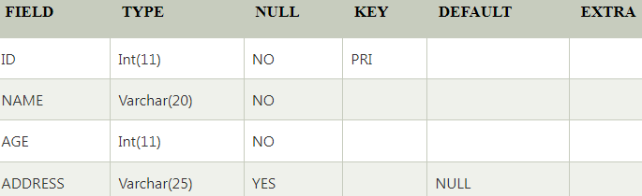
Example:
SQL> CREATE TABLE STUDENTS (
ID INT NOT NULL,
NAME VARCHAR (20) NOT NULL,
AGE INT NOT NULL,
ADDRESS VARCHAR (25),
PRIMARY KEY (ID)
);
You can see the structure of your table by using disc command.
Example: SQL> DESC STUDENTS;

Slide 37
DROP , TRUNCATE and Rename TABLE
DROP:
It is used to delete a table definition and all data from a table.
This is very important to know that once a table is deleted all the information available in the table is lost forever, so we have to be very careful when using this command.
Syntax: DROP TABLE <table_name>;
Truncate:
It is used to delete all the rows from the table and free the containing space.
Syntax: TRUNCATE TABLE <table_name>;
RENAME TABLE
Any database user can easily change the name by using the RENAME TABLE and ALTER TABLE statement in Structured Query Language.
The RENAME TABLE and ALTER TABLE syntax help in changing the name of the table.
Syntax: RENAME table old_table _name To new_table_name ;
Example:
RENAME table Students To students_22 ;

Slide 38
AGGRATION FUNCTIONS

Slide 39
AGGRATION FUNCTIONS:
Aggregation functions are used to perform mathematical operations on data values of a relation.
take a collection (a set or multiset) of values as input and return a single value.
Some of the common aggregation functions used in SQL are:
Average: avg
Minimum: min
Maximum: max
Total: sum
Count: count

Slide 40
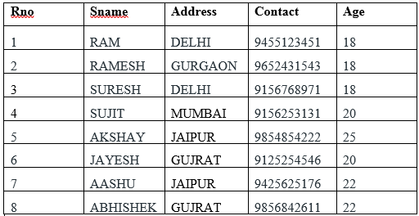
Example Table : “Student”

Slide 41
Count:
Query: SELECT COUNT (PHONE) FROM STUDENT;
Output: 8
SUM:
Query: SELECT SUM (AGE) FROM STUDENT;
163
AVG:
Query: SELECT AVG (AGE) FROM STUDENT;
20.37
MAX:
Query: SELECT MAX (AGE) FROM STUDENT;
25
MIN:
Query: SELECT MIN (AGE) FROM STUDENT;
18

Slide 42
Set Operations

Slide 43
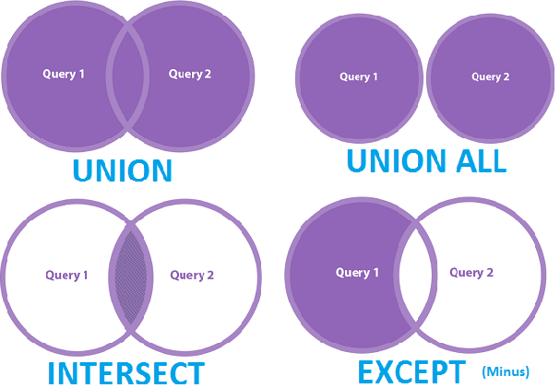
Set operators are used to combine results from two or more SELECT statements.
They combine the same type of data from two or more tables.
This looks similar to SQL joins although there is a difference.
SQL joins are used to combine columns whereas Set operators are used to join rows from multiple SELECT queries.
They return only one result set.
These operators work on complete rows of the queries, so the results of the queries must have the same column name, same column order and the types of columns must be compatible.

Slide 44
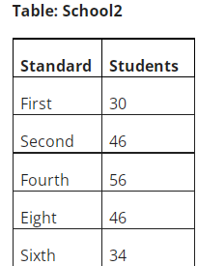
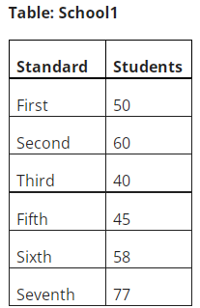

Slide 45
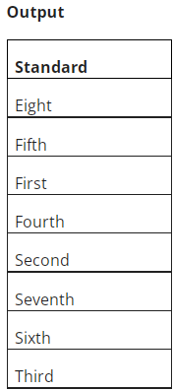
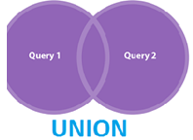
1. UNION Operator
The UNION operator combines two or more result sets into a single result set, without duplications.
The union of two queries gives rows that are present in the first result set or in the second result set or in both.
But each row appears only once.
Example
SELECT Standard FROM School1
UNION
SELECT Standard FROM School2

Slide 46
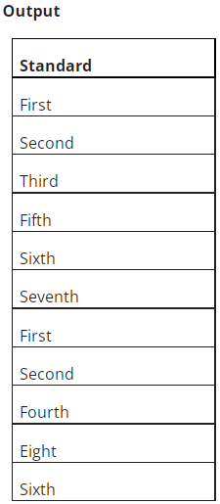
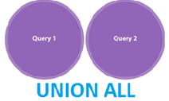
2. UNION ALL Operators
Like the UNION operator the UNION ALL operator also combines two or more result sets into a single result set.
The only difference between a UNION and UNION ALL is that the UNION ALL allows duplicate rows.
Example
SELECT Standard FROM School1
UNION ALL
SELECT Standard FROM School2

Slide 47
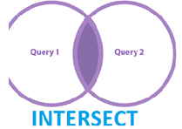
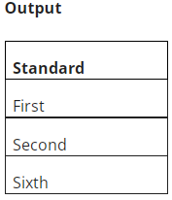
3. INTERSECT Operator
The INTERSECT operator returns only the rows present in all the result sets.
The intersection of two queries gives the rows that are present in both result sets.
It returns only unique rows.
Example
SELECT Standard FROM School1
INTERSECT
SELECT Standard FROM School2

Slide 48
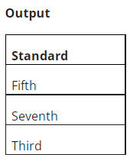
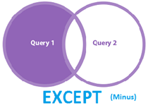
4. EXCEPT Operator
The EXCEPT operator returns all distinct the rows that are present in the result set of the first query, but not in the result set of the second query.
It means it returns the difference between the two result sets.
Example
SELECT Standard FROM School1
EXCEPT
SELECT Standard FROM School2

Slide 49
Examples
1. Consider following relational tables:
Student (S_ID, Name, Dept_name)
Course ( course_ID, c_name, Dept_name)
Trainer (ID, name, dept_name)
Dept (Dept_ID, dept_name)
Solve above relation using DDL statements with primary key and Foreign key.

Slide 50
NULL Value
A field with a NULL value is a field with no value.
If a field in a table is optional, it is possible to insert a new record or update a record without adding a value to this field.
Then, the field will be saved with a NULL value.
It is not possible to test for NULL values with comparison operators, such as =, <, or <>.
We will have to use the IS NULL and IS NOT NULL operators instead.

Slide 51
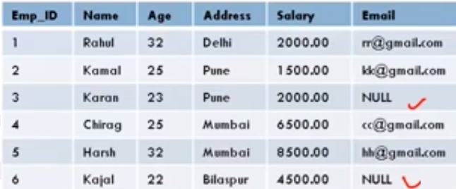

Slide 52
DML COMMANDS

Slide 53
DML(Data Manipulation Language)
Data Manipulation Language, DML, is the part of SQL used to manipulate data within objects of a relational database.
There are three basic DML commands:
INSERT
UPDATE
DELETE

Slide 54
Data Manipulation commands
A DML is a language that enables users to access or manipulate data as organized by the appropriate data model.
The types of access are:
Retrieval of information stored in the database
Insertion of new information into the database
Deletion of information from the database
Modification of information stored in the database

Slide 55
INSERT Command
Insert statement is used to insert data into database tables.
Syntax:
INSERT INTO <TABLE NAME> ( <COLUMNS TO INSERT> ) VALUES
( <VALUES TO INSERT> )
OR
INSERT INTO <TABLE NAME> VALUES
( <VALUES TO INSERT> )

Slide 56
Insert into students (ID, NAME, AGE, ADDRESS)values (1,’Rakesh’,20,’Pune’);
Or
Insert into students values (1,’Rakesh’,20,’Pune’);
Output:

Slide 57

UPDATE command
The SQL commands (UPDATE and DELETE) are used to modify the data that is already in the database.
`The SQL DELETE command uses a WHERE clause.
SQL UPDATE statement is used to change the data of the records held by tables.
Which rows is to be update, it is decided by a condition. To specify condition, we use WHERE clause.
Syntax: UPDATE table_name SET [column_name1= value1,... column_nameN = valueN] [WHERE condition]

Slide 58
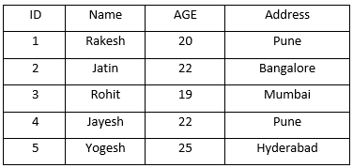
Example:
UPDATE students
SET Name = ’Yogesh'
WHERE Student_Id = ’5’

Slide 59
DELETE command
DELETE:
The DELETE statement is used to delete rows from a table.
If you want to remove a specific row from a table you should use WHERE condition.
Syntax: DELETE FROM table_name [WHERE condition];
OR
DELETE FROM table_name;

Slide 60
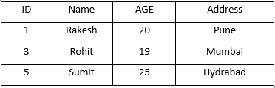
Example:
Delete * from students;
DELETE FROM students where age=“22”;

Slide 61
Complex Retrieval Queries using Group By

Slide 62
GROUP BY and HAVING Clause
The GROUP BY clause is a SQL command that is used to group rows that have the same values.
The GROUP BY clause is used in the SELECT statement.
Optionally it is used in conjunction with aggregate functions to produce summary reports from the database.
That’s what it does, summarizing data from the database.
The queries that contain the GROUP BY clause are called grouped queries and only return a single row for every grouped item.

Slide 63
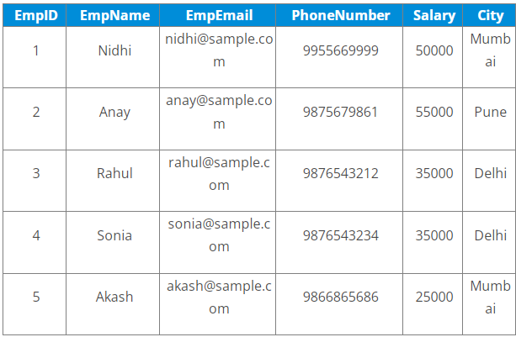
Examples:
Use GROUP BY on single column
GROUP BY on multiple columns
Use GROUP BY with ORDER BY
GROUP BY with HAVING clause
Use GROUP BY with JOINS

Slide 64
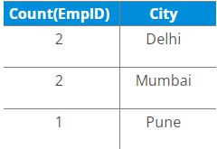
GROUP BY on single column
Example:
Find no. of employees per city.
Query:
SELECT COUNT(EmpID), City
FROM Employees
GROUP BY City;

Slide 65
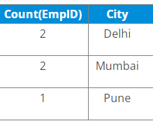
GROUP BY with ORDER BY
When we use the SQL GROUP BY statement with the ORDER BY clause, the values get sorted either in ascending or descending order.
Example:
Write a query to retrieve the number of employees in each city, sorted in descending order.
SELECT COUNT(EmpID), City
FROM Employees
GROUP BY City
ORDER BY COUNT(EmpID) DESC;

Slide 66
GROUP BY with HAVING clause
The SQL GROUP BY statement is used with ‘HAVING’ clause to mention conditions on groups.
Also, since we cannot use the aggregate functions with the WHERE clause, we have to use the ‘HAVING’ clause to use the aggregate functions with GROUP BY.
Example:
Write a query to retrieve the number of employees in each city, having salary > 15000
SELECT COUNT(EmpID), City
FROM Employees
GROUP BY City
HAVING SALARY > 15000;
(Since all are records in the Employee table have a salary > 15000,
we will see the following table as output)

Slide 67
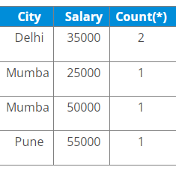
GROUP BY on multiple columns
Example:
Write a query to retrieve the number of employees having different salaries in each city.
SELECT City, Salary, Count(*)
FROM Employees
GROUP BY City, Salary;

Slide 68
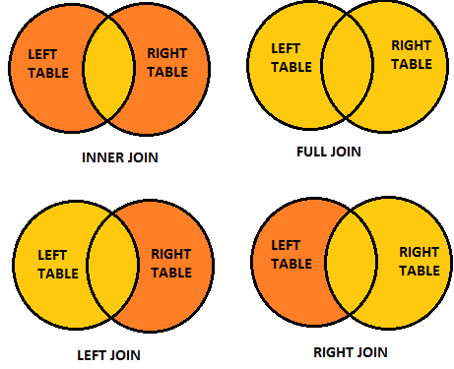
JOIN

Slide 69
SQL Join statement is used to combine data or rows from two or more tables based on a common field between them.
Different types of Joins are as follows:
INNER JOIN
LEFT JOIN
RIGHT JOIN
FULL JOIN

Slide 70
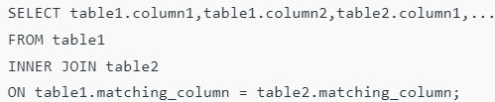

INNER JOIN
Returns records that have matching values in both tables.
We can also write JOIN instead of INNER JOIN. JOIN is same as INNER JOIN.
This keyword will create the result-set by combining all rows from both the tables where the condition satisfies
i.e value of the common field will be the same.
Syntax:

Slide 71
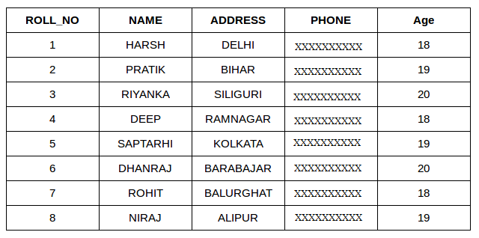
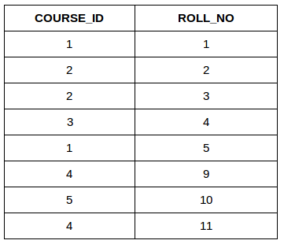
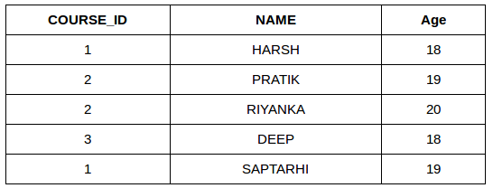
Student Course
SELECT Course.COURSE_ID, Student.NAME, Student.AGE FROM Student
INNER JOIN Course
ON Student.ROLL_NO = Course.ROLL_NO;

Slide 72
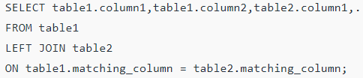
LEFT JOIN
This join returns all the rows of the table on the left side of the join and matches rows for the table on the right side of the join.
For the rows for which there is no matching row on the right side, the result-set will contain null.
LEFT JOIN is also known as LEFT OUTER JOIN.
Syntax:

Slide 73
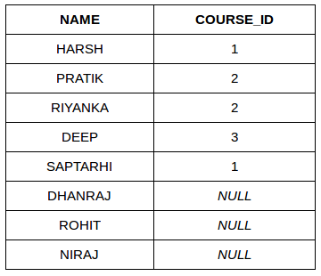
Example
SELECT Student.NAME,Course.COURSE_ID FROM Student
LEFT JOIN Course
ON Course.ROLL_NO = Student.ROLL_NO;

Slide 74
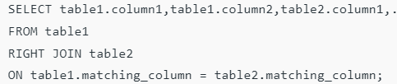
RIGHT JOIN
This join returns all the rows of the table on the right side of the join and matching rows for the table on the left side of the join.
For the rows for which there is no matching row on the left side, the result-set will contain null.
RIGHT JOIN is also known as RIGHT OUTER JOIN.
Syntax:

Slide 75

Example:
SELECT Student.NAME, Course.COURSE_ID
FROM Student
RIGHT JOIN Course
ON Course.ROLL_NO = Student.ROLL_NO;

Slide 76

FULL JOIN
FULL JOIN creates the result-set by combining results of both LEFT JOIN and RIGHT JOIN.
The result-set will contain all the rows from both tables.
For the rows for which there is no matching, the result-set will contain NULL values.
SELECT table1

Slide 77

Example:
SELECT Student.NAME, Course.COURSE_ID
FROM Student
FULL JOIN Course
ON Course.ROLL_NO = Student.ROLL_NO;

Slide 78



Example 2: full join

Slide 79
DCL COMMANDS
DCL includes commands such as GRANT and REVOKE which mainly deal with the rights, permissions, and other controls of the database system.
Syntax:
GRANT privileges_names ON object TO user;
Parameters Used:
privileges_name: These are the access rights or privileges granted to the user.
object: It is the name of the database object to which permissions are being granted. In the case of granting privileges on a table, this would be the table name.
user: It is the name of the user to whom the privileges would be granted.

Slide 80


Privileges:

Slide 81
Different ways of granting privileges to the users:
Granting SELECT Privilege to a User in a Table:
To grant Select Privilege to a table named “users” where User Name is Amit,
the following GRANT statement should be executed.
GRANT SELECT ON Users TO'Amit'@'localhost;
Granting more than one Privilege to a User in a Table:
To grant multiple Privileges to a user named “Amit” in a table “users”, the
following GRANT statement should be executed.
GRANT SELECT, INSERT, DELETE, UPDATE ON Users TO ‘Amit'@'localhost;

Slide 82
Granting All the Privilege to a User in a Table:
To Grant all the privileges to a user named “Amit” in a table “users”, the
following Grant statement should be executed.
GRANT ALL ON Users TO 'Amit'@'localhost;
Granting a Privilege to all Users in a Table:
To Grant a specific privilege to all the users in a table “users”, the following
Grant statement should be executed.
GRANT SELECT ON Users TO '*'@'localhost;
In the above example the “*” symbol is used to grant select permission to all the users of the table “users”.

Slide 83
Revoke command
Revoke command withdraw user privileges on database objects if any granted.
It does operations opposite to the Grant command.
When a privilege is revoked from a particular user U, then the privileges granted to all other users by user U will be revoked.
Syntax:
REVOKE privileges ON object FROM user;
grant insert,
select on accounts to Ram
By the above command user ram has granted permissions on accounts database object like he can query or insert into accounts.
revoke insert,
select on accounts from Ram
By the above command user ram’s permissions like query or insert on accounts database object has been removed.

Slide 84
Examples
if you wanted to revoke DELETE and UPDATE privileges on a table called contacts from a user named smith:
REVOKE DELETE, UPDATE ON contacts FROM 'smith'@'localhost';
If you wanted to revoke all permissions (except GRANT OPTION) on a table for a user named smith:
REVOKE ALL ON contacts FROM 'smithj'@'localhost';
If you had granted SELECT privileges to * (ie: all users) on
the contacts table and you wanted to revoke these privileges:
REVOKE SELECT ON contacts FROM '*'@'localhost';

Slide 85
Aliases and DISTINCT
Aliases
In SQL, we can use the same name for two (or more) attributes as long as the attributes are in different relations
Aliases are the temporary names given to tables or columns for the purpose of a particular SQL query.
It is used when the name of a column or table is used other than its original name, but the modified name is only temporary.
Slide 8- 85
Notes:
85

Slide 86
Alias cntd…
Aliases are created to make table or column names more readable.
The renaming is just a temporary change and the table name does not change in the original database.
Aliases are useful when table or column names are big or not very readable.
These are preferred when there is more than one table involved in a query.

Slide 87
ALIASES
Some queries need to refer to the same relation twice
In this case, aliases are given to the relation name
Query 1: For each employee, retrieve the employee's name, and the name of his or her immediate supervisor. Q1: SELECT E.FNAME, E.LNAME, S.FNAME, S.LNAME FROM EMPLOYEE E S WHERE E.SUPERSSN=S.SSN
In Q1, the alternate relation names E and S are called aliases or tuple variables for the EMPLOYEE relation
We can think of E and S as two different copies of EMPLOYEE; E represents employees in role of supervisees(employee) and S represents employees in role of supervisors
Slide 8- 87
Notes:
87

Slide 88
Syntax for Column Alias
SELECT column as alias_name FROM table_name;
column: fields in the table
Column Alias
Example:
SELECT CustomerID AS SSN FROM Customer;

Slide 89
Table Alias
Generally, table aliases are used to fetch the data from more than just a single table and connect them through field relations.
To fetch the CustomerName and Country of the customer with Age = 21.
Example:
SELECT s.CustomerName, d.Salary
FROM Customer AS s, Department
AS d WHERE s.Age=21 AND
s.DNO=d.DNO;

Slide 90
USE OF DISTINCT
SQL does not treat a relation as a set; duplicate tuples can appear
To eliminate duplicate tuples in a query result, the keyword DISTINCT is used
For example, the result of Q11 may have duplicate SALARY values whereas Q11A does not have any duplicate values Q11: SELECT SALARY FROM EMPLOYEE
Q11A: SELECT DISTINCT SALARY FROM EMPLOYEE
Slide 8- 90
Notes:
90

Slide 91
Logical Operators

Slide 92
LIKE condition
LIKE condition is used to perform pattern matching to find the correct result.
It is used in SELECT, INSERT, UPDATE and DELETE statement with the combination of WHERE clause.
Syntax:
expression LIKE pattern [ ESCAPE 'escape_character' ]
Parameters
expression: It specifies a column or field.
pattern: It is a character expression that contains pattern matching.
escape_character: It is optional. It allows you to test for literal instances of a wildcard character such as % or _. If you do not provide the escape_character, MySQL assumes that "\" is the escape_character.

Slide 93

Different LIKE operators with '%' and '_' wildcards:

Slide 94




Examples
1) Using % (percent) Wildcard:
2) Using _ (Underscore) Wildcard:
3) using not like:

Slide 95
AND, OR and NOT Operators
The WHERE clause can be combined with AND, OR, and NOT operators.
The AND and OR operators are used to filter records based on more than one condition:
The AND operator displays a record if all the conditions separated by AND are TRUE.
The OR operator displays a record if any of the conditions separated by OR is TRUE.
The NOT operator displays a record if the condition(s) is NOT TRUE.

Slide 96





Slide 97




Slide 98
IN Condition
The IN operator allows you to specify multiple values in a WHERE clause.
The IN operator is a shorthand for multiple OR conditions.
Syntax
SELECT column_name(s) FROM table_name WHERE column_name IN (value1, value2, ...);
OR
SELECT column_name(s) FROM table_name WHERE column_name IN (SELECT STATEMENT);

Slide 99




Examples

Slide 100

BETWEEN Operator
The BETWEEN operator selects values within a given range. The values can be numbers, text, or dates.
The BETWEEN operator is inclusive: begin and end values are included.
Syntax
SELECT column_name(s) FROM table_name WHERE column_name BETWEEN value1 AND value2;

Slide 101
ANY Operator
The ANY operator is used to verify if any single record of a query satisfies the required condition.
This operator returns a TRUE, if the given condition is satisfied for any of the values in the range.
If none of the values in the specified range satisfy the given condition, this operator returns false.
You can also use another query (subquery) along with this operator.

Slide 102
Syntax
Column_name operator ANY (subquery);
column_name is the name of a column in the main query.
operator is a comparison operator such as =, <, >, <=, >=, or <>.
subquery is a SELECT statement that returns a single column of values.

Slide 103

Example:
Consider the CUSTOMERS table which contains the personal details of customers including their name, age, address and salary etc.

Slide 104

list out the details of all the CUSTOMERS whose SALARY is greater than the SALARY of any customer whose AGE is 32.
SELECT * FROM CUSTOMERS WHERE SALARY > ANY (SELECT SALARY FROM CUSTOMERS WHERE AGE = 32);

Slide 105
ALL Operator
The SQL ALL operator returns all the records of the SELECT statement.
It returns TRUE if the given condition is satisfied for ALL the values in the range.
It always returns a Boolean value.
It is used with SELECT, WHERE and HAVING statements in SQL queries.
The data type of the values returned from a subquery must be the same as the outer query expression data type.

Slide 106
Syntax:
Column_name operator ALL (subquery);
Example
The details of all the customers whose salary is not equal to the salary of any customer whose age is 25
SELECT * FROM CUSTOMERS WHERE SALARY <> ALL (SELECT SALARY FROM CUSTOMERS WHERE AGE = 25);

Slide 107


Slide 108
Views
Views is a virtual table.
A view can represent a subset of a real table, selecting certain columns or certain rows from an ordinary table.
A view can even represent joined tables.
Because views are assigned separate permissions, you can use them to restrict table access so that the users see only specific rows or columns of a table.
A view can be created from one or many tables

Slide 109

View

Slide 110
Creating view
The PostgreSQL views are created using the CREATE VIEW statement.
The PostgreSQL views can be created from a single table, multiple tables, or another view.
CREATE [TEMP|TEMPORARY] VIEW view_name
AS SELECT column1, column2.....
FROM table_name
WHERE [condition];
If the optional TEMP or TEMPORARY keyword is present, the view will be created in the temporary space.
Temporary views are automatically dropped at the end of the current session

Slide 111


Example
CREATE VIEW COMPANY_VIEW
AS SELECT ID, NAME, AGE
FROM COMPANY;
SELECT * FROM COMPANY_VIEW;
This would produce the following result −

Slide 112
Dropping Views
Obviously, where you have a view, you need a way to drop the view if it is no longer needed.
The syntax is very simple and is given below −
DROP VIEW view_name;
Following is an example to drop the CUSTOMERS_VIEW from the CUSTOMERS table.
DROP VIEW CUSTOMERS_VIEW;

Slide 113
Advantages of PostgreSQL views
1) Simplifying complex queries
Views help simplify complex queries.
Typically, you first create views based on complex queries and store them in the database.
Then, you can use simple queries based on views instead of using complex queries.
2) Security and access control
You can create views that expose subsets of data in the base tables, hiding sensitive information.
This is particularly useful when you have applications that require access to distinct portions of the data.
3) Logical data independence
If your applications use views, you can freely modify the structure of the

Slide 114
Updating a View
A view can be updated under certain conditions which are given below −
The SELECT clause may not contain the keyword DISTINCT.
The SELECT clause may not contain summary functions.
The SELECT clause may not contain set functions.
The SELECT clause may not contain set operators.
The SELECT clause may not contain an ORDER BY clause.
The FROM clause may not contain multiple tables.
The WHERE clause may not contain subqueries.
The query may not contain GROUP BY or HAVING.
Calculated columns may not be updated.
All NOT NULL columns from the base table must be included in the view in order for the
INSERT query to function.

Slide 115
Inserting Rows into a View
Rows of data can be inserted into a view. The same rules that apply to the UPDATE
command also apply to the INSERT command.
Here, we cannot insert rows in the CUSTOMERS_VIEW because we have not included all the NOT NULL columns in this view, otherwise you can insert rows in a view in a similar way as you insert them in a table.
Deleting Rows into a View
Rows of data can be deleted from a view. The same rules that apply to the UPDATE and INSERT commands apply to the DELETE command.
Following is an example to delete a record having AGE = 22.
SQL > DELETE FROM CUSTOMERS_VIEW WHERE age = 22;
This would ultimately delete a row from the base table CUSTOMERS and the same would reflect in the view itself

Slide 116
Dropping Views
Obviously, where you have a view, you need a way to drop the view if
it is no longer needed. The syntax is very simple and is given below −
DROP VIEW view_name;
Following is an example to drop the CUSTOMERS_VIEW from the CUSTOMERS table.
DROP VIEW CUSTOMERS_VIEW;

Slide 117
Creating View from multiple tables
View from multiple tables can be created by simply include multiple tables in the SELECT statement.
In the given example, a view is created named MarksView from two tables
Student_Detail and Student_Marks.
Syntax:
CREATE VIEW view_name AS
SELECT table1.col_name1, table1.col_name2,table2.col_name1 FROM table1,table2
WHERE table1.col_name = Table2.col_name; (matching column)
Example:
CREATE VIEW MarksView AS
SELECT Student_Detail.NAME, Student_Detail.ADDRESS, Student_Marks.MARKS FROM Student_Detail, Student_Mark
WHERE Student_Detail.NAME = Student_Marks.NAME;

Slide 118
Triggers

Slide 119
Triggers
A trigger is a special type of stored procedure that automatically runs when an event occurs in the database server.
DML triggers run when a user tries to modify data through a data manipulation language (DML) event.
DML events are INSERT, UPDATE, or DELETE statements on a table or view.
These triggers fire when any valid event fires, whether table rows are affected or not.

Slide 120

Create Triger syntax:
Explanation of syntax:
create trigger [trigger_name]:
Creates or replaces an existing trigger with the trigger_name.
[before | after]:
This specifies when the trigger will be executed.
{insert | update | delete}:
This specifies the DML operation.
on [table_name]:
This specifies the name of the table associated with the trigger.

Slide 121
[for each row]:
This specifies a row-level trigger, i.e., the trigger will be executed for each row being affected.
[trigger_body]:
This provides the operation to be performed as trigger is fired
BEFORE and AFTER of Trigger:
BEFORE triggers run the trigger action before the triggering statement is run.
AFTER triggers run the trigger action after the triggering statement is run.

Slide 122


For example, before or after the triggering event the OLD and NEW signify the row's states in the table.
How to Create a New Trigger
We will follow the below process to generate a new trigger in PostgreSQL:
Step1: Firstly, we will create a trigger function with the help of the CREATE FUNCTION command.
Step2: Then, we will fix the trigger function to a table with the help of the CREATE TRIGGER command.
Step 1: Syntax of Create trigger function
Step 2: Syntax of Creating trigger

Slide 123
Trigger
Step 1: Syntax of Create trigger function
Step 2: Syntax of Creating trigger

Slide 124


Trigger _function example

Slide 125
Example 2
write a code to implement trigger in postgresql. create table student(id,name,mark1,mark2,total) apply trigger on it, when new row will be inserted into student table total will be calculated automatically. (total=marks1+marks2)

Slide 126







Slide 127
Nested Queries in SQL

Slide 128
A complete SELECT query, called a nested query, can be specified within the WHERE-clause of another query, called the outer query
Subqueries can be used with the SELECT, INSERT, UPDATE, and DELETE statements along with the operators like =, <, >, >=, <=, IN, BETWEEN, etc.
There are a few rules that subqueries must follow −
Subqueries must be enclosed within parentheses.
A subquery can have only one column in the SELECT clause, unless multiple columns are in the main query for the subquery to compare its selected columns.
An ORDER BY command cannot be used in a subquery, although the main query can use an ORDER BY.
The GROUP BY command can be used to perform the same function as the ORDER BY in a subquery.
Subqueries that return more than one row can only be used with multiple value operators such as the IN operator.
The BETWEEN operator cannot be used with a subquery. However, the BETWEEN operator can be used within the subquery.

Slide 129


Nested Queries
In nested queries, a query is written inside a query. The result of inner query is used in execution of outer query.
Here we use STUDENT & city tables for understanding nested queries.

Slide 130



Subqueries with the SELECT Statement

Slide 131



Subqueries with the INSERT Statement
The INSERT statement uses the data returned from the subquery to insert into another table.
The selected data in the subquery can be modified with any of the character, date or number functions.
Syntax:

Slide 132

INSERT INTO Student1 SELECT * FROM Student2;

Slide 133



To delete students from Student2 table whose rollno is same as that in Student1 table and having location as ‘Chennai’.

Slide 134



Example 2:

Slide 135


Subqueries with the UPDATE Statement
The subquery can be used in conjunction with the UPDATE statement.
Either single or multiple columns in a table can be updated when using a subquery with the UPDATE statement.
Syntax:

Slide 136
NESTING OF QUERIES cntd..
Query 1: Retrieve the name and address of all employees who work for the 'Research' department.
Q1: SELECT FNAME, LNAME, ADDRESS FROM EMPLOYEE WHERE DNO IN
(SELECT DNUMBER FROM DEPARTMENT WHERE DNAME='Research' )
Slide 8- 136
Notes:
136

Slide 137
NESTING OF QUERIES (contd.)
The nested query selects the number of the 'Research' department
The outer query select an EMPLOYEE tuple if its DNO value is in the result of either nested query
The comparison operator IN compares a value v with a set (or multi-set) of values V, and evaluates to TRUE if v is one of the elements in V
In general, we can have several levels of nested queries
A reference to an unqualified attribute refers to the relation declared in the innermost nested query
In this example, the nested query is not correlated with the outer query
Slide 8- 137
Notes:
137

Slide 138
CORRELATED NESTED QUERIES
If a condition in the WHERE-clause of a nested query references an attribute of a relation declared in the outer query, the two queries are said to be correlated
The result of a correlated nested query is different for each tuple (or combination of tuples) of the relation(s) the outer query
Query 12: Retrieve the name of each employee who has a dependent with the same first name as the employee. Q12: SELECT E.FNAME, E.LNAME FROM EMPLOYEE AS E WHERE E.SSN IN (SELECT ESSN FROM DEPENDENT WHERE ESSN=E.SSN AND E.FNAME=DEPENDENT_NAME)
Slide 8- 138
Notes:
138

Slide 139
CORRELATED NESTED QUERIES (contd.)
In Q12, the nested query has a different result in the outer query
A query written with nested SELECT... FROM... WHERE... blocks and using the = or IN comparison operators can always be expressed as a single block query. For example, Q12 may be written as in Q12A
Q12A: SELECT E.FNAME, E.LNAME FROM EMPLOYEE E, DEPENDENT D WHERE E.SSN=D.ESSN AND E.FNAME=D.DEPENDENT_NAME
Slide 8- 139
Notes:
139

Slide 140
CORRELATED NESTED QUERIES (contd.)
The original SQL as specified for SYSTEM R also had a CONTAINS comparison operator, which is used in conjunction with nested correlated queries
This operator was dropped from the language, possibly because of the difficulty in implementing it efficiently
Most implementations of SQL do not have this operator
The CONTAINS operator compares two sets of values, and returns TRUE if one set contains all values in the other set
Reminiscent of the division operation of algebra
Slide 8- 140
Notes:
140

Slide 141
CORRELATED NESTED QUERIES (contd.)
Query 3: Retrieve the name of each employee who works on all the projects controlled by department number 5.
Q3: SELECT FNAME, LNAME FROM EMPLOYEE WHERE ( (SELECT PNO FROM WORKS_ON WHERE SSN=ESSN) CONTAINS (SELECT PNUMBER FROM PROJECT WHERE DNUM=5) )
Slide 8- 141
Notes:
141

Slide 142
CORRELATED NESTED QUERIES (contd.)
In Q3, the second nested query, which is not correlated with the outer query, retrieves the project numbers of all projects controlled by department 5
The first nested query, which is correlated, retrieves the project numbers on which the employee works, which is different for each employee tuple because of the correlation
Slide 8- 142
Notes:
142

Slide 143
THE EXISTS FUNCTION
EXISTS is used to check whether the result of a correlated nested query is empty (contains no tuples) or not
We can formulate Query 12 in an alternative form that uses EXISTS as Q12B
Slide 8- 143
Notes:
143

Slide 144
THE EXISTS FUNCTION (contd.)
Query 12: Retrieve the name of each employee who has a dependent with the same first name as the employee.
Q12B: SELECT FNAME, LNAME FROM EMPLOYEE WHERE EXISTS (SELECT * FROM DEPENDENT WHERE SSN=ESSN AND FNAME=DEPENDENT_NAME)
Slide 8- 144
Notes:
144

Slide 145
THE EXISTS FUNCTION (contd.)
Query 6: Retrieve the names of employees who have no dependents.
Q6: SELECT FNAME, LNAME FROM EMPLOYEE WHERE NOT EXISTS (SELECT * FROM DEPENDENT WHERE SSN=ESSN)
In Q6, the correlated nested query retrieves all DEPENDENT tuples related to an EMPLOYEE tuple. If none exist, the EMPLOYEE tuple is selected
EXISTS is necessary for the expressive power of SQL
Slide 8- 145
Notes:
145

Slide 146

TCL Commands

Slide 147
Transaction Control Languages.
These commands are used for maintaining consistency of the database and for the management of transactions made by the DML commands.
A Transaction is a set of SQL statements that are executed on the data stored in DBMS.
Whenever any transaction is made these transactions are temporarily happen in database.
So to make the changes permanent, we use TCL commands.

Slide 148


TCL

Slide 149
TCL Commands:
1. COMMIT :
This command is used to save the data permanently.
Whenever we perform any of the DML command like -INSERT, DELETE or UPDATE, these can be rollback if the data is not stored permanently.
So in order to be at the safer side COMMIT command is used.
Syntax: commit;
2. ROLLBACK :
This command is used to get the data or restore the data to the last savepoint or last committed state.
If due to some reasons the data inserted, deleted or updated is not correct, you can rollback the data to a particular savepoint or if savepoint is not done, then to the last committed state.
Syntax: rollback;

Slide 150
3. SAVEPOINT :
This command is used to save the data at a particular point temporarily, so that whenever needed can be rollback to that particular point.
Syntax: Savepoint A;

Slide 151


Example:
Consider the following Table Student:
UPDATE STUDENT SET NAME = ‘Sherlock’ WHERE NAME = ‘Jolly’;
COMMIT;
ROLLBACK;
By using this command you can update the record and save it permanently by using COMMIT command.
Now after COMMIT :
If commit was not performed then the changes made by the update command can be rollback.

Slide 152




Example:

Slide 153



Savepoint
If on the given table savepoint is performed
Now if we Rollback to Savepoint B:
Rollback to B;
The resulting Table will be-

Slide 154

Now if we Rollback to Savepoint A:
Rollback to A;
The resulting Table will be-

Slide 155
Example
Consider the following employee database.
Employee(emp_name, street,city,date_of_joining)
Works(emp_name,company_name,salary)
Company(company_name,city)
Manages(emp_name,manager_name)
Write SQL queries for following:
Modify the database so that ‘Deepa’lives in ‘Pune’;
Give all employees of ‘Aarya corporation’ a 10% rise in salary.
Display all employees who joined in the month of ‘March’;
Find all employees who earn more than average salary of all employees of their company.

